Slide 1
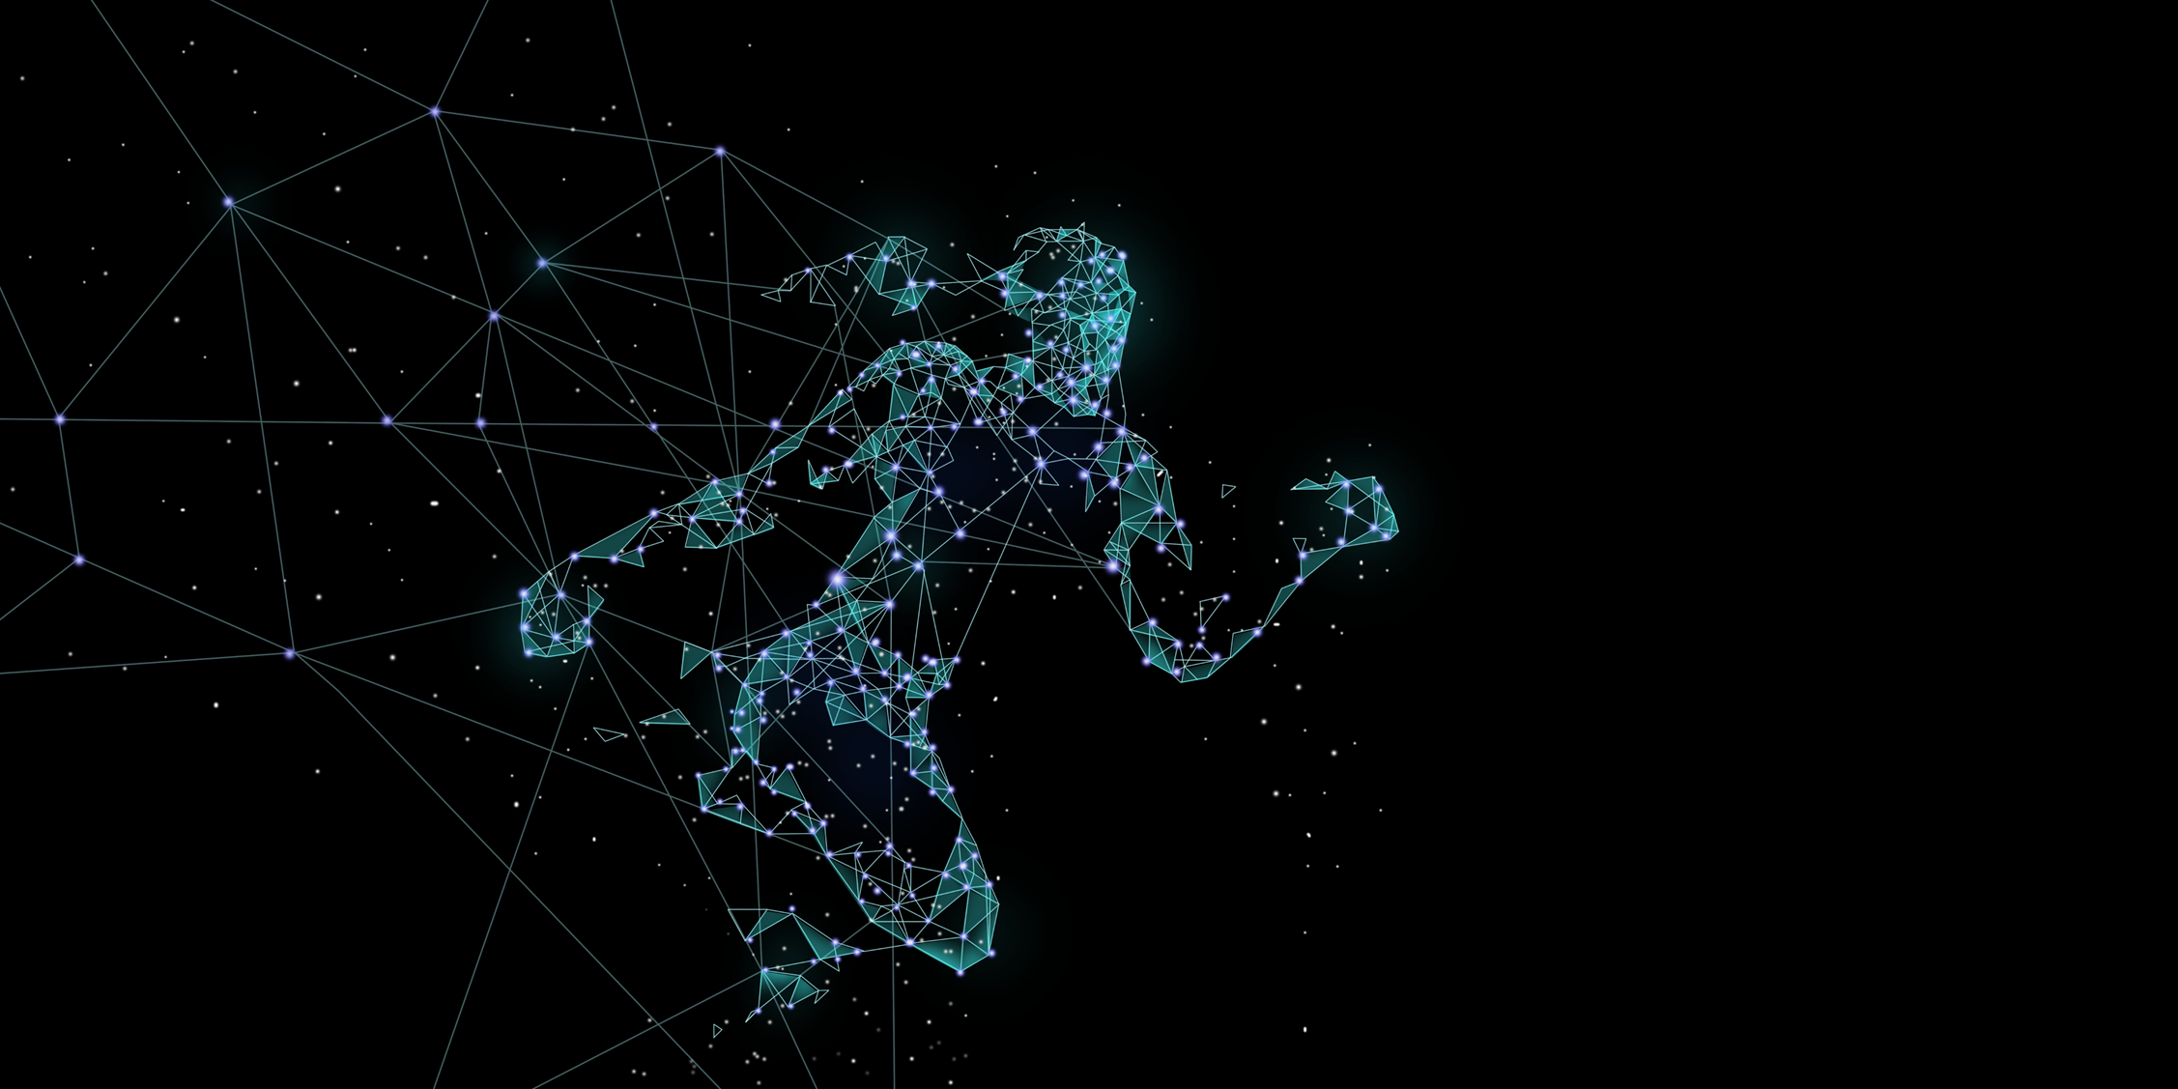
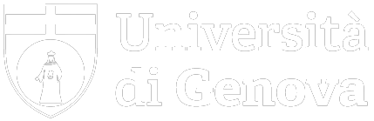
"A comparative analysis across algorithmic,
machine learning, and visual paradigms for
the automatic detection of the perceived
origin of full-body human movement"
Master Degree Thesis Computer Engineering
Candidates:
Fausto Martina – 4515876
Romano Gabriele – 5383588
Advisors:
Prof. Volpe Gualtiero
Prof. Oneto Luca

Slide 2
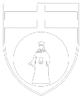
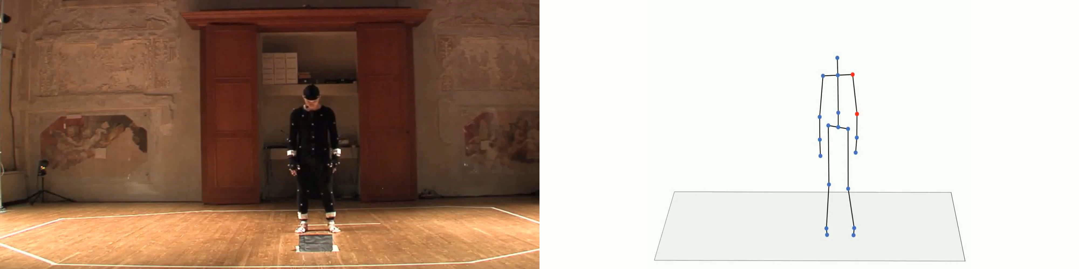
Origin of movement

Slide 3
Problem statement
What we want to do
Why this is important
Innovativeness
Improve sport performances
Visualization approach enables considerations on the origin of movement and also on multiple origins
Develop new methods for estimating and classifying the origin of movement
Injuries prevention and rehabilitation
Perform self-assessment and correct movements independently, without the need for a coach's presence
Machine Learning approach that has not been implemented before

Slide 4
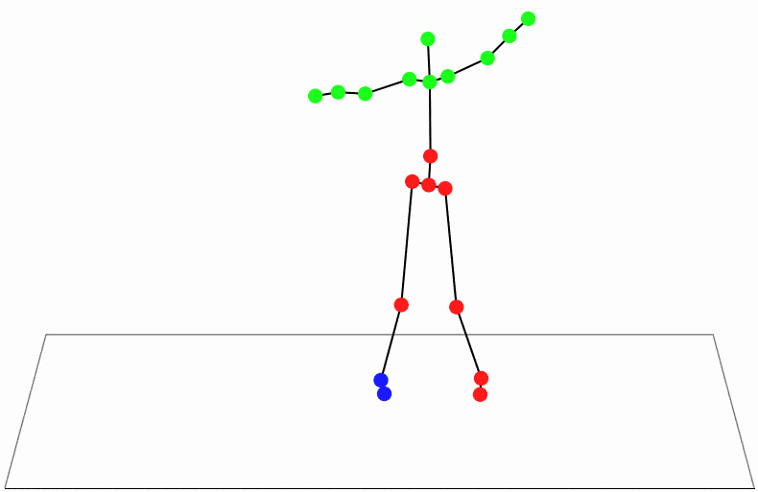
Outline of our work
Feature
extraction
Input
Model
Output
Approach
Trajectory’s derivatives
(velocity, etc.)
Graph
Multiclass classification on the whole body
Raw data
Clustering
Algorithmic
Dataset
Perfect Matching
Visualization
Statistical
descriptors
of the trajectories
Random
Forest
Binary classification
on specific edges
Machine Learning

Slide 5
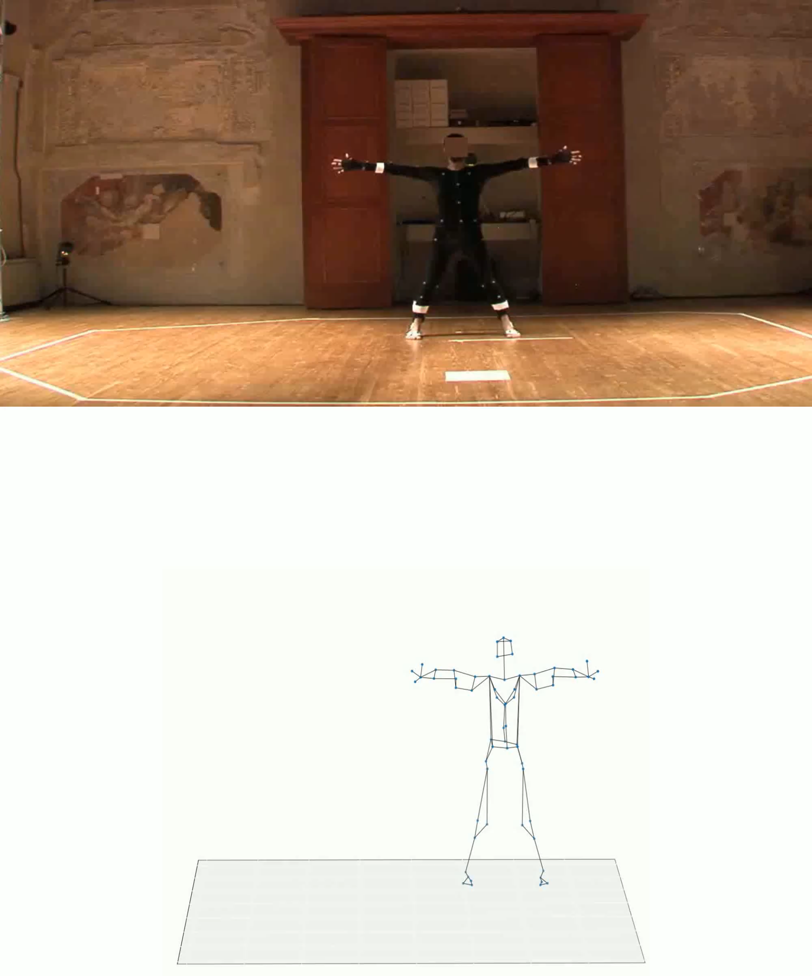
Raw Data
Video Recordings
Fragments selection
We selected short segments where we observed the OoM
Validation
The annotation and the validation of the OoM was made by us, the professor and an experienced dancer
MoCap
Markers Compression
We compressed the markers from 64 and 41 into a skeleton with 20 nodes

Slide 6
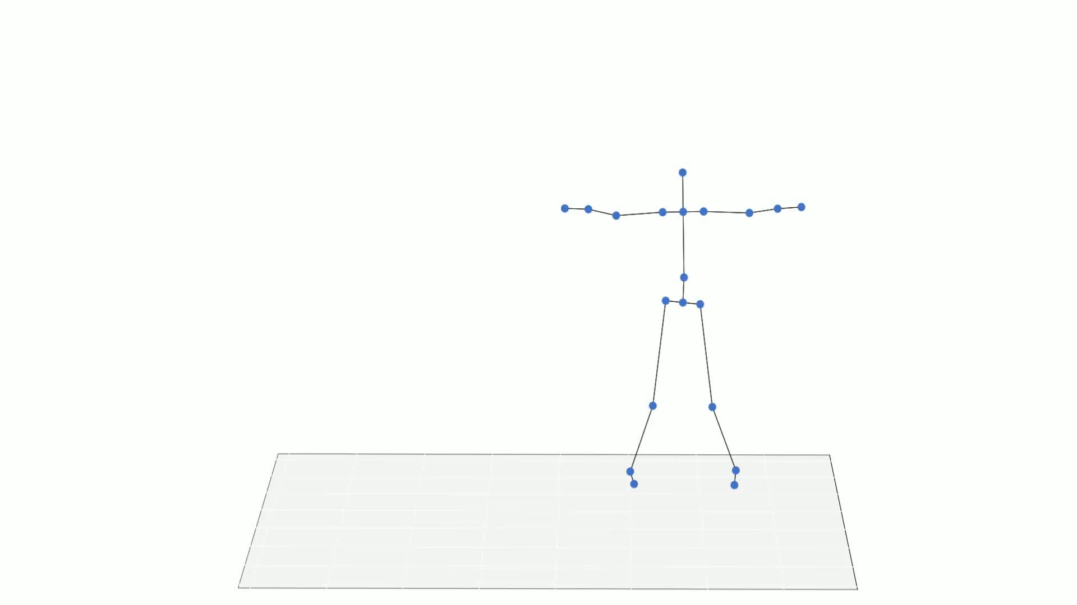
Dataset
Skeleton model
Classification
There are 19 possible classes corresponding to the edges of the skeleton and each sample is characterized by a single class
Dataset composition
60 time series of each of the 20 joint in three-dimensional space
Distribution
The dataset in unbalanced and
4 classes are never assumed in the dataset

Slide 7
Algorithmic Approach
What it is
A method that compares features such as velocity, acceleration, and angular momentum of various joints, classifying nodes physically connected with more dissimilar feature values as the origin of the movement
What it is for
It can potentially provide multiple OoM if the candidate joints for OoM are not physically linked

Slide 8
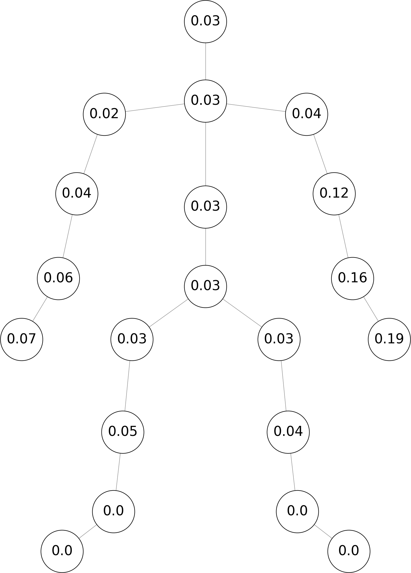
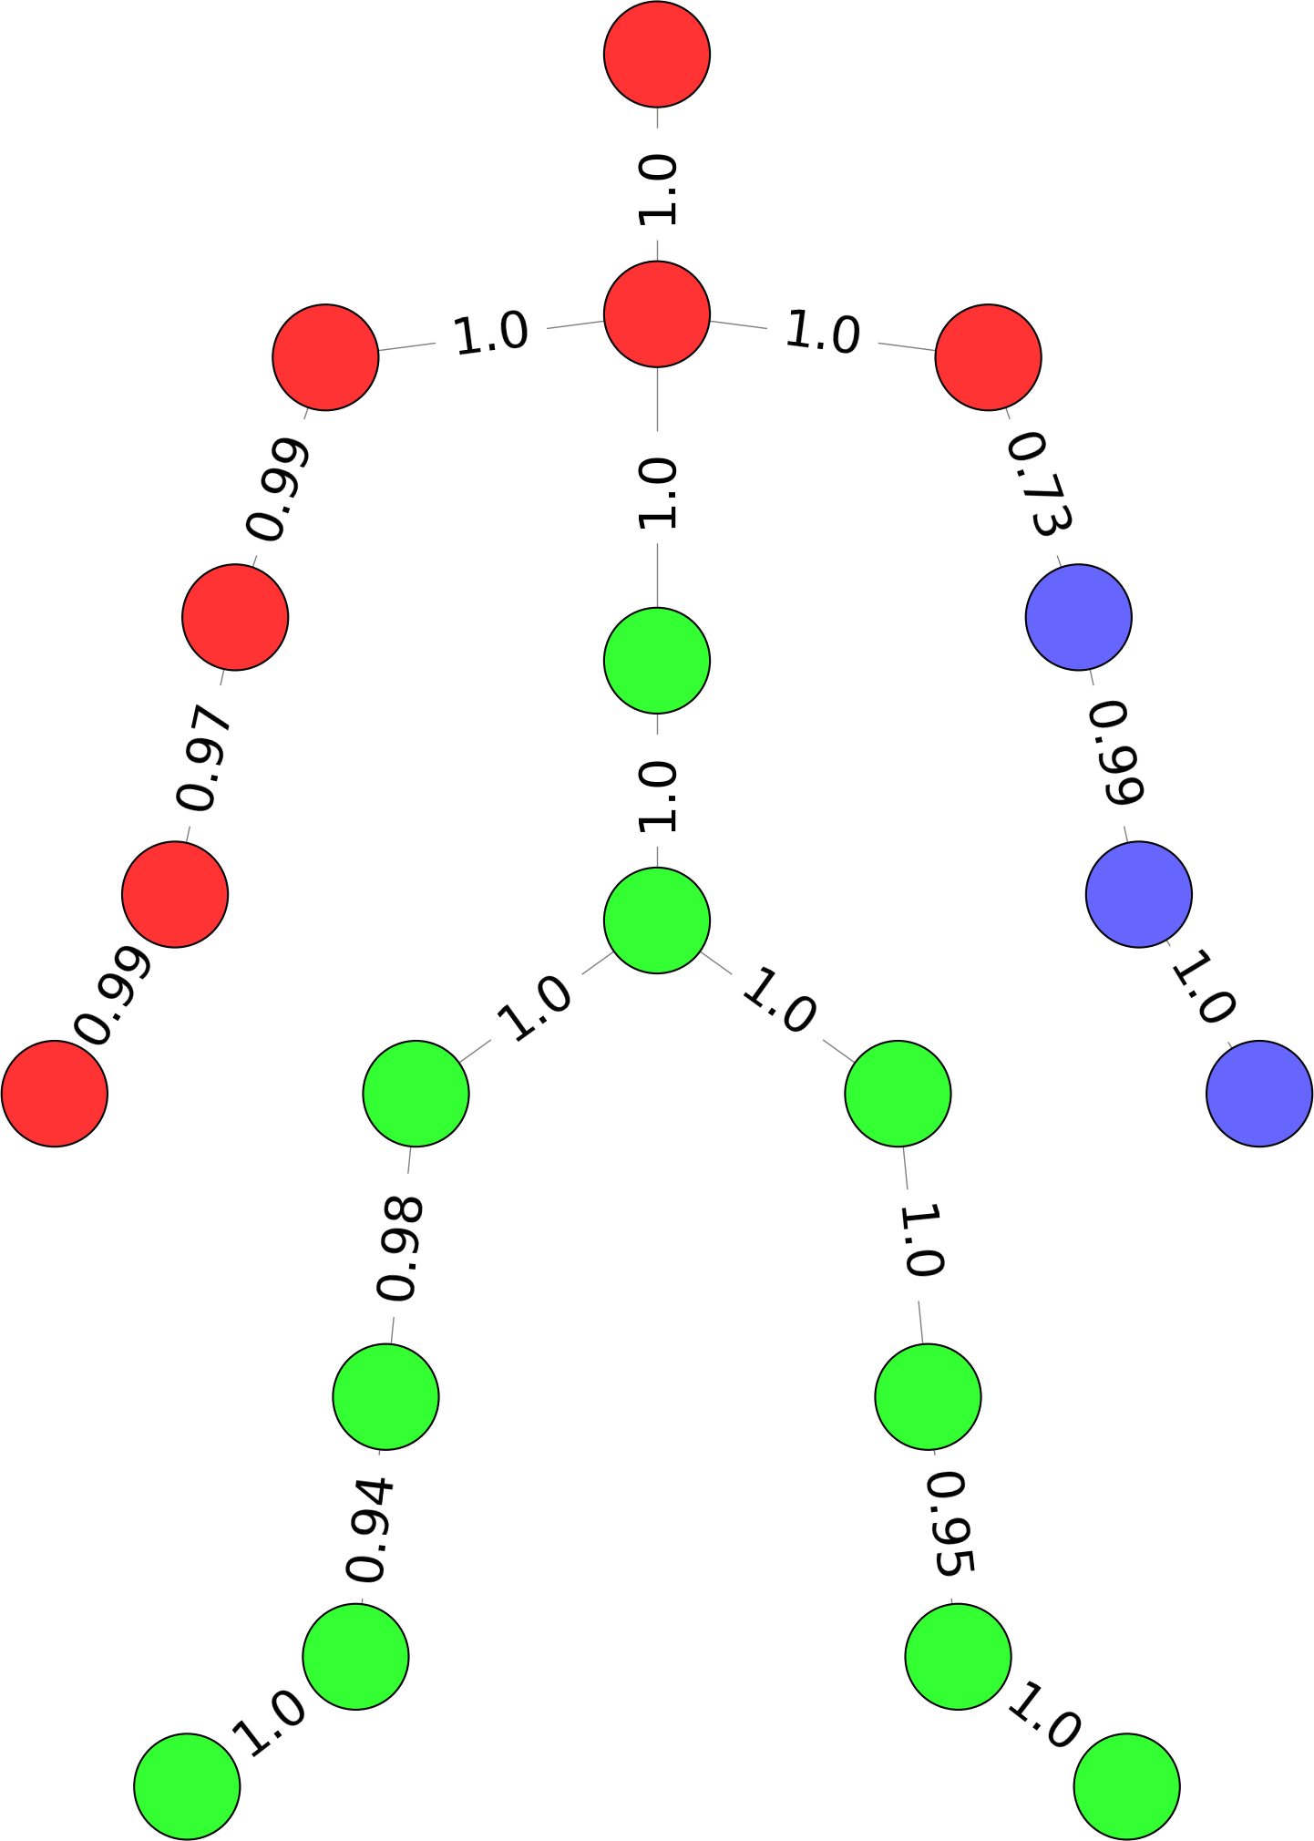
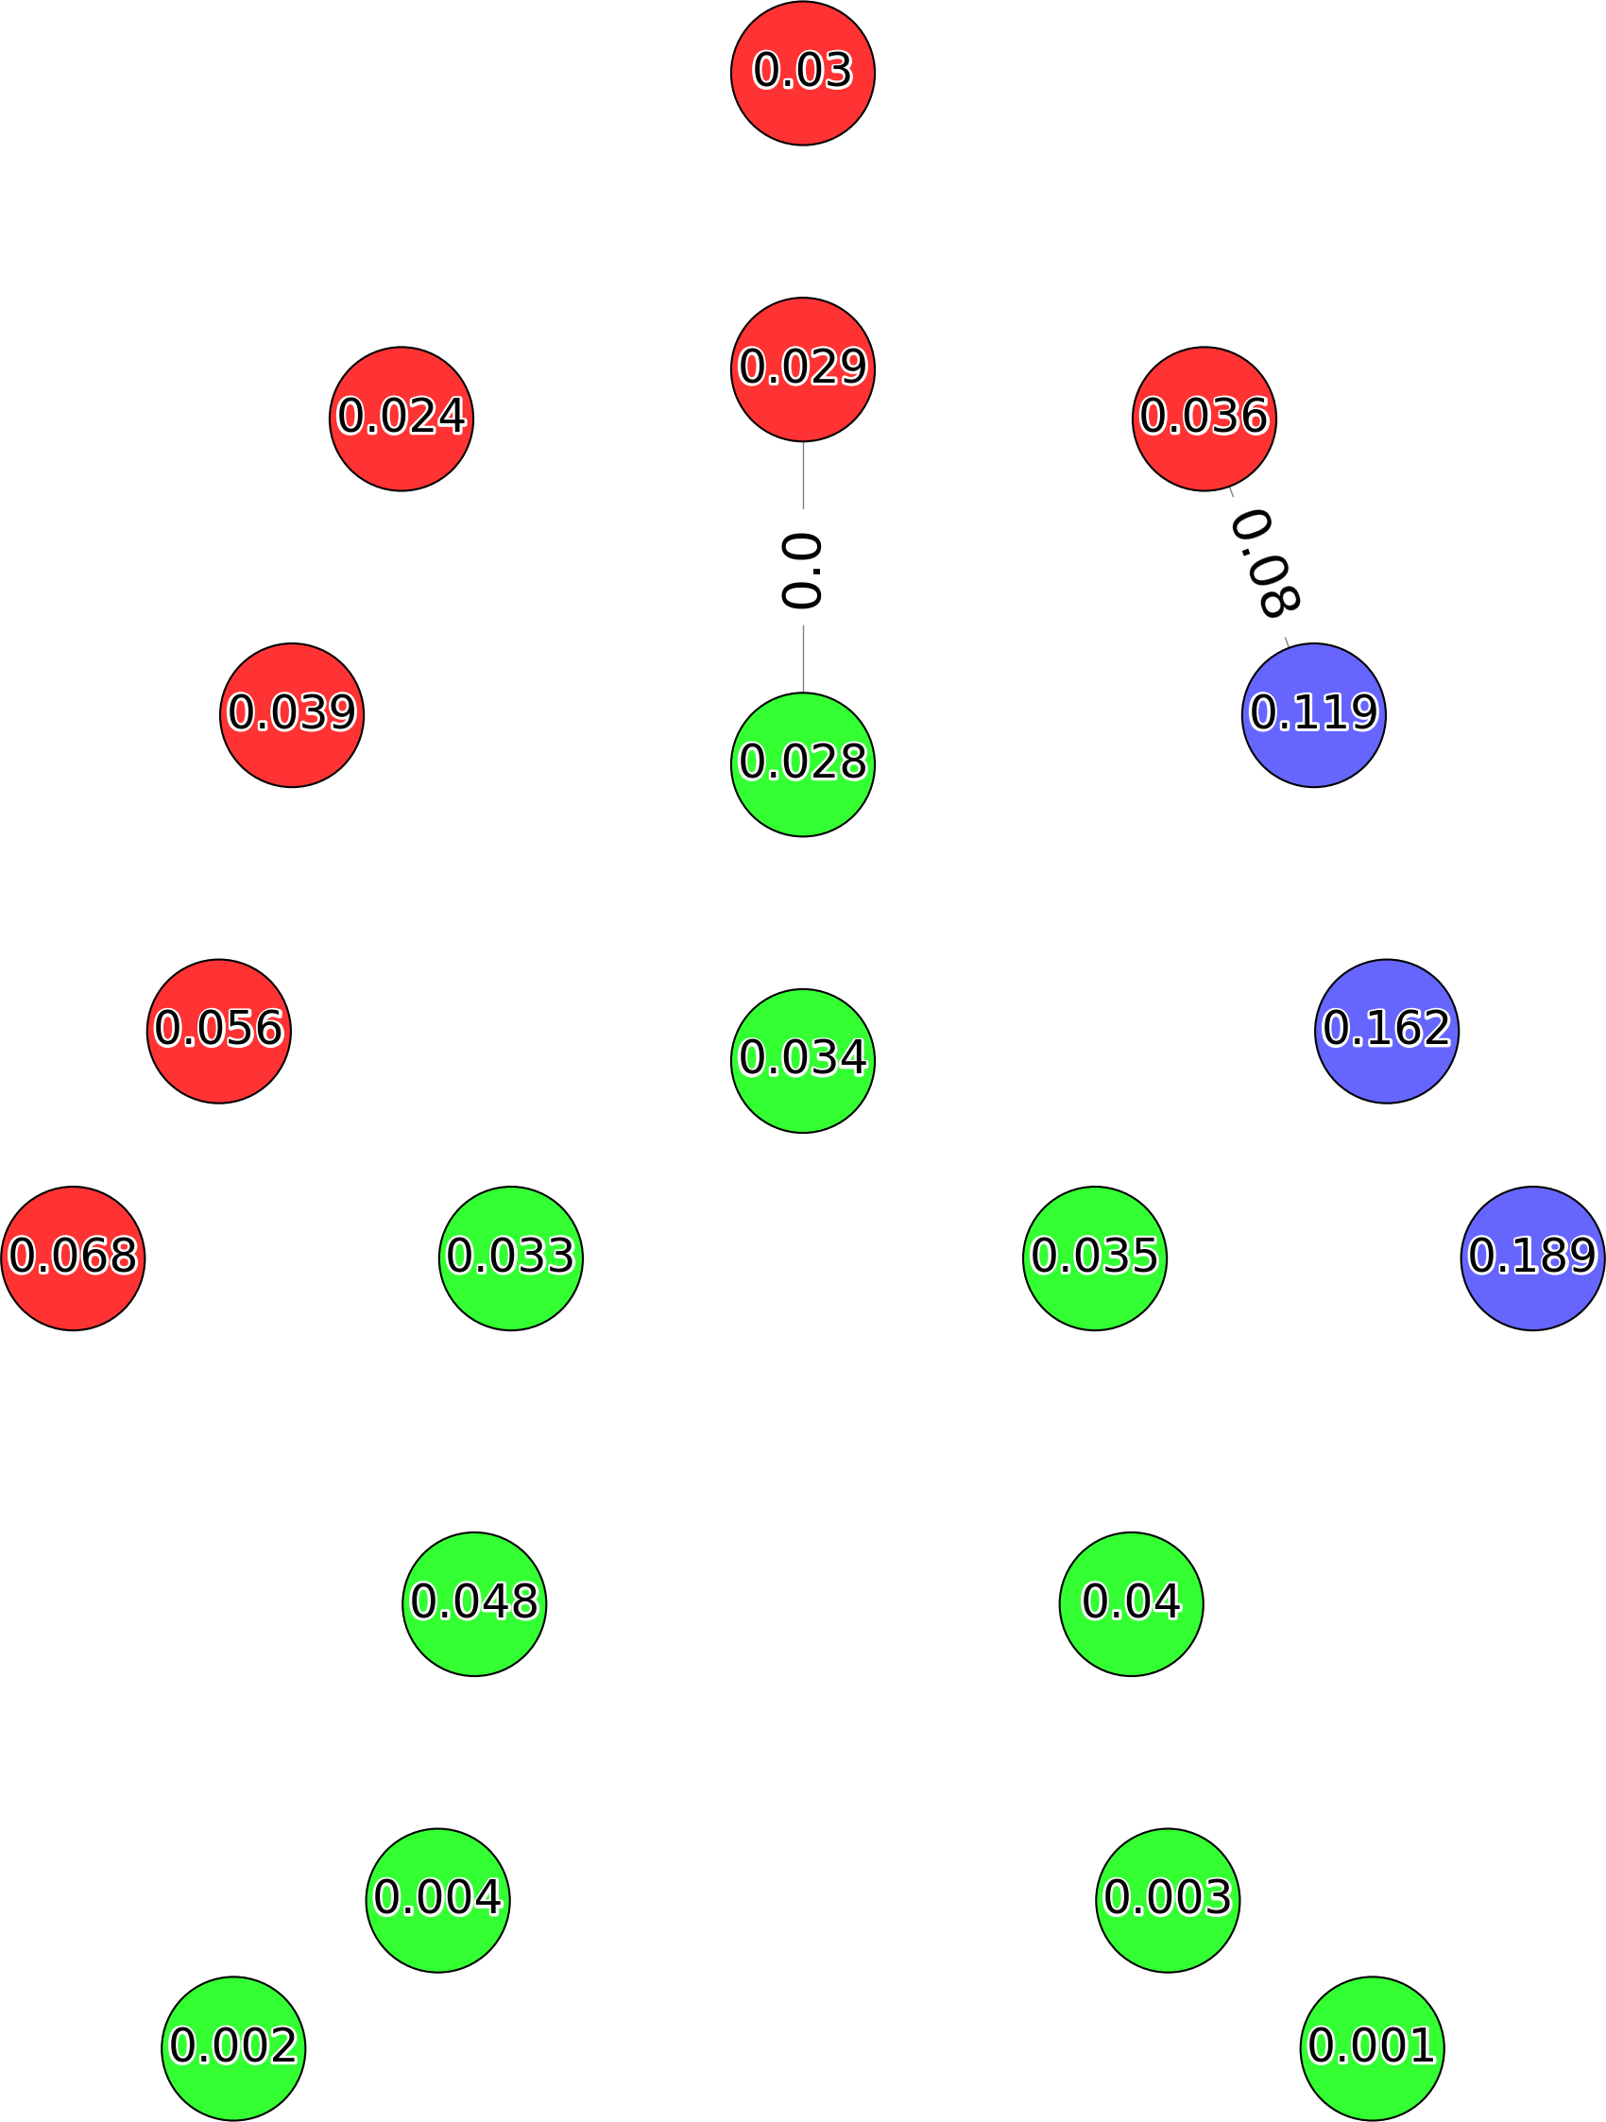
Algorithmic Approach
Feature extraction
Features (velocity, acceleration, angular momentum) extraction for every joint
Spectral clustering on the adjacency matrix
Cosine Similarity
Shi-Malik spectral clustering
Auxiliary Graph
Euclidean distance is calculated on adjacent nodes of different clusters to find edges’ weight

Slide 9
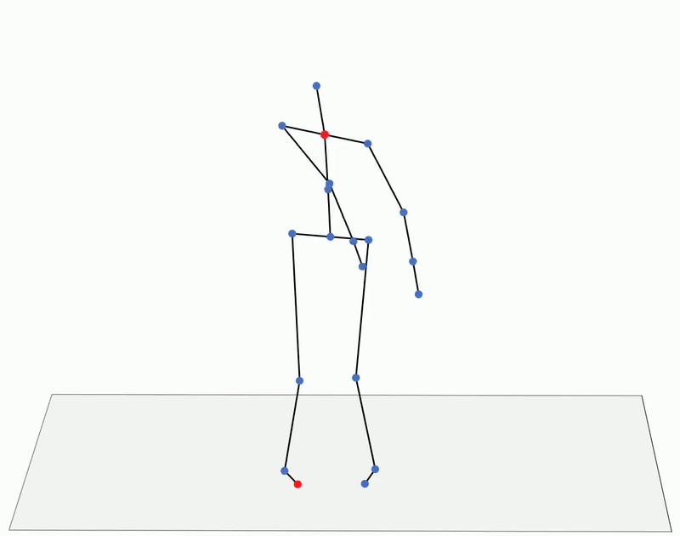
Algorithmic Approach
Weighted Degree Centrality calculated for each frame
Once all frames are processed, the two most frequent maximums across all frames are selected
When compared to the ground truth, it will be considered correct if one of the two nodes is at one of the two ends of the edge identified as OoM

Slide 10
Visualization Approach
What it is
Approach used to make considerations on OoM by visualizing how clusters grouping joints with similar characteristics change during the execution of a movement
What it is for
It can be useful to better visualize which parts of the body move for example at the same velocity during a motion and how changes in velocity occur to initiate specific movements
Method
Setting a
Maximum Weight Perfect Match problem and solving it applying the Hungarian Algorithm

Slide 11
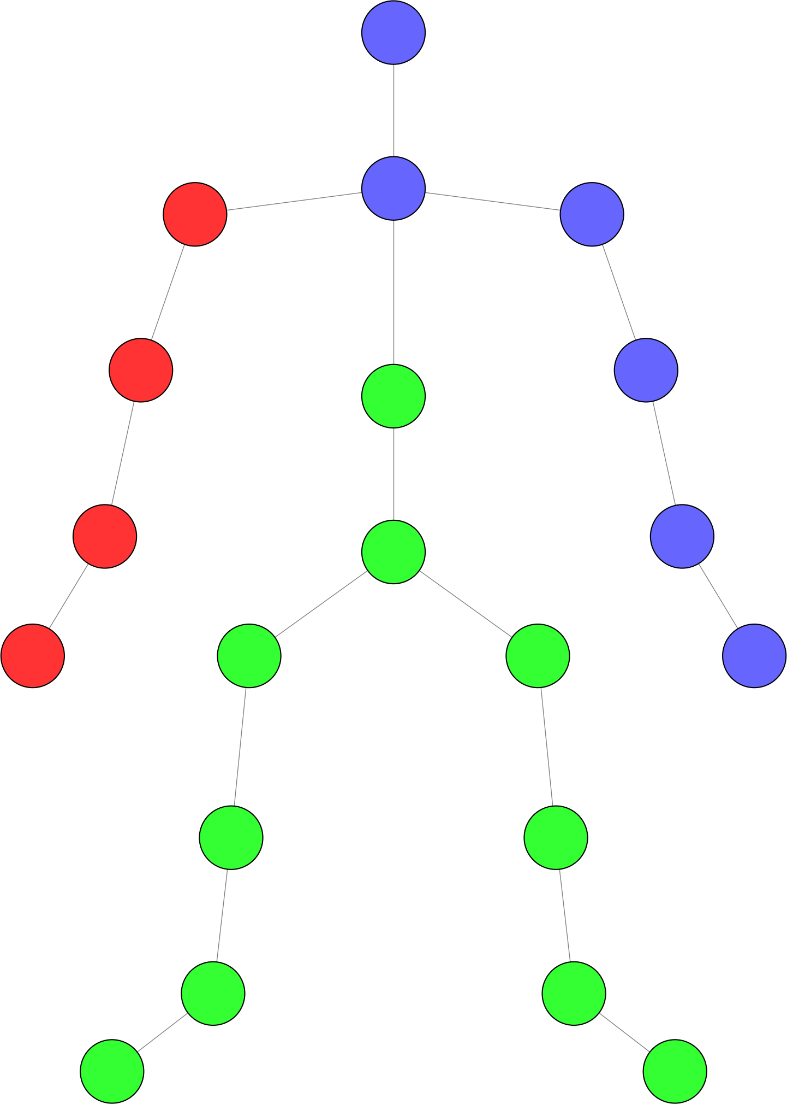
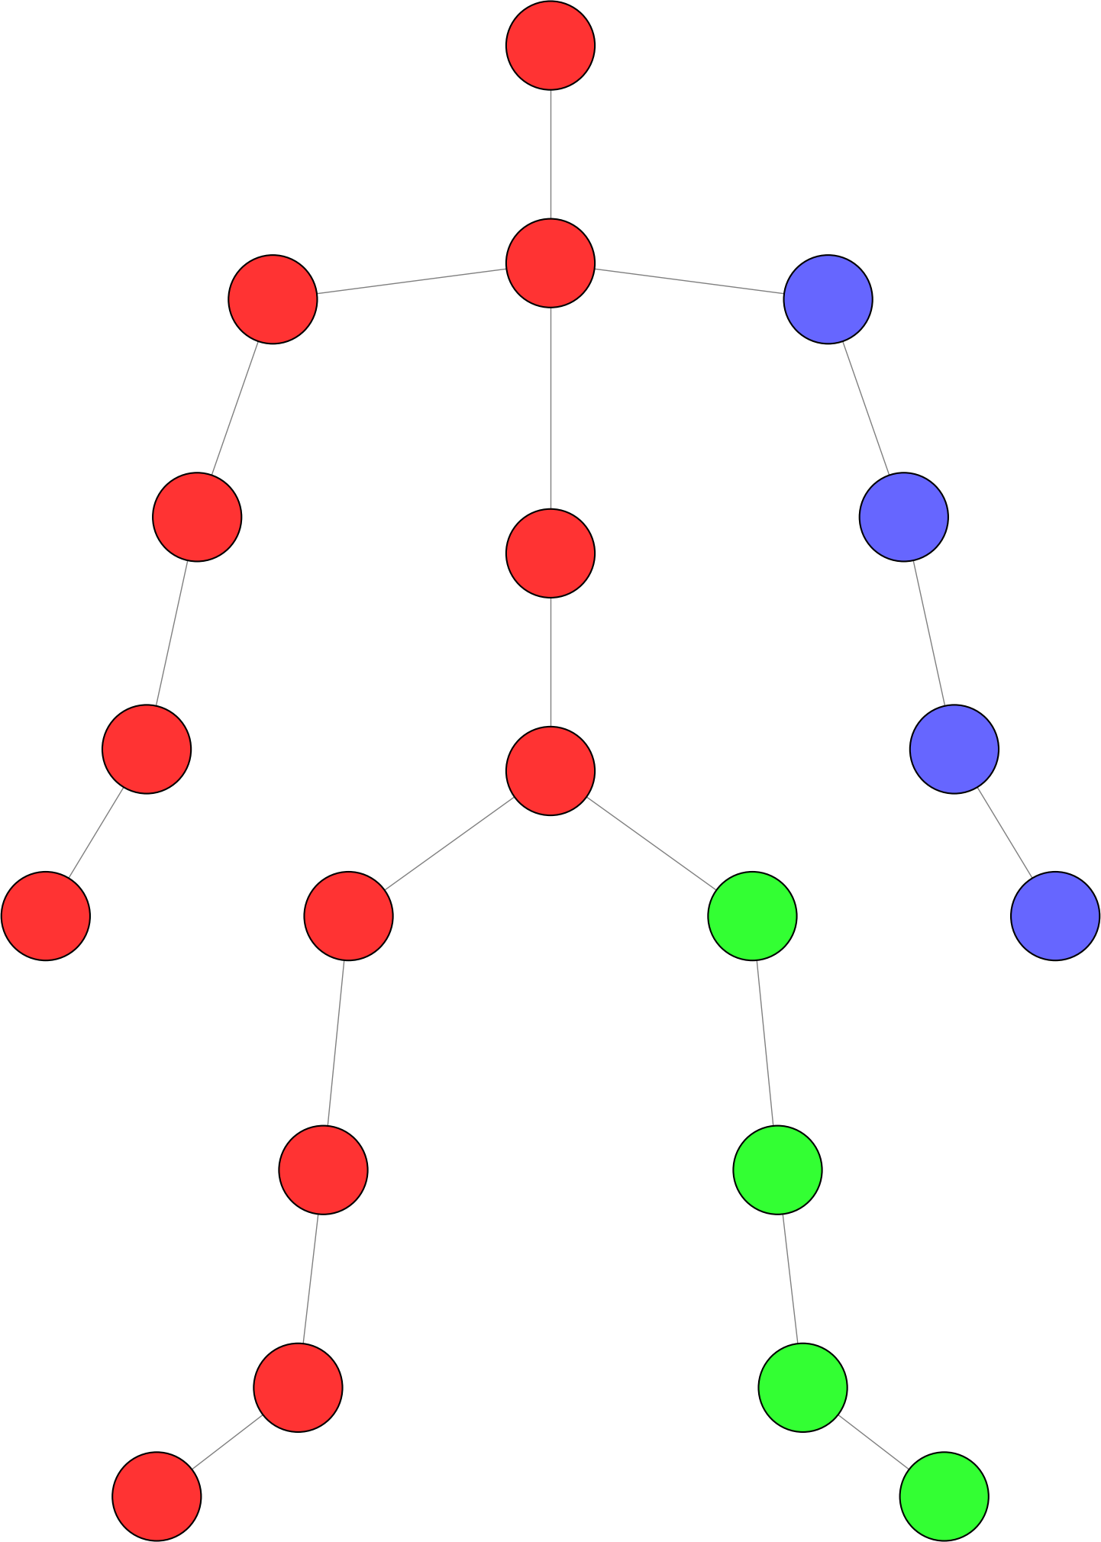
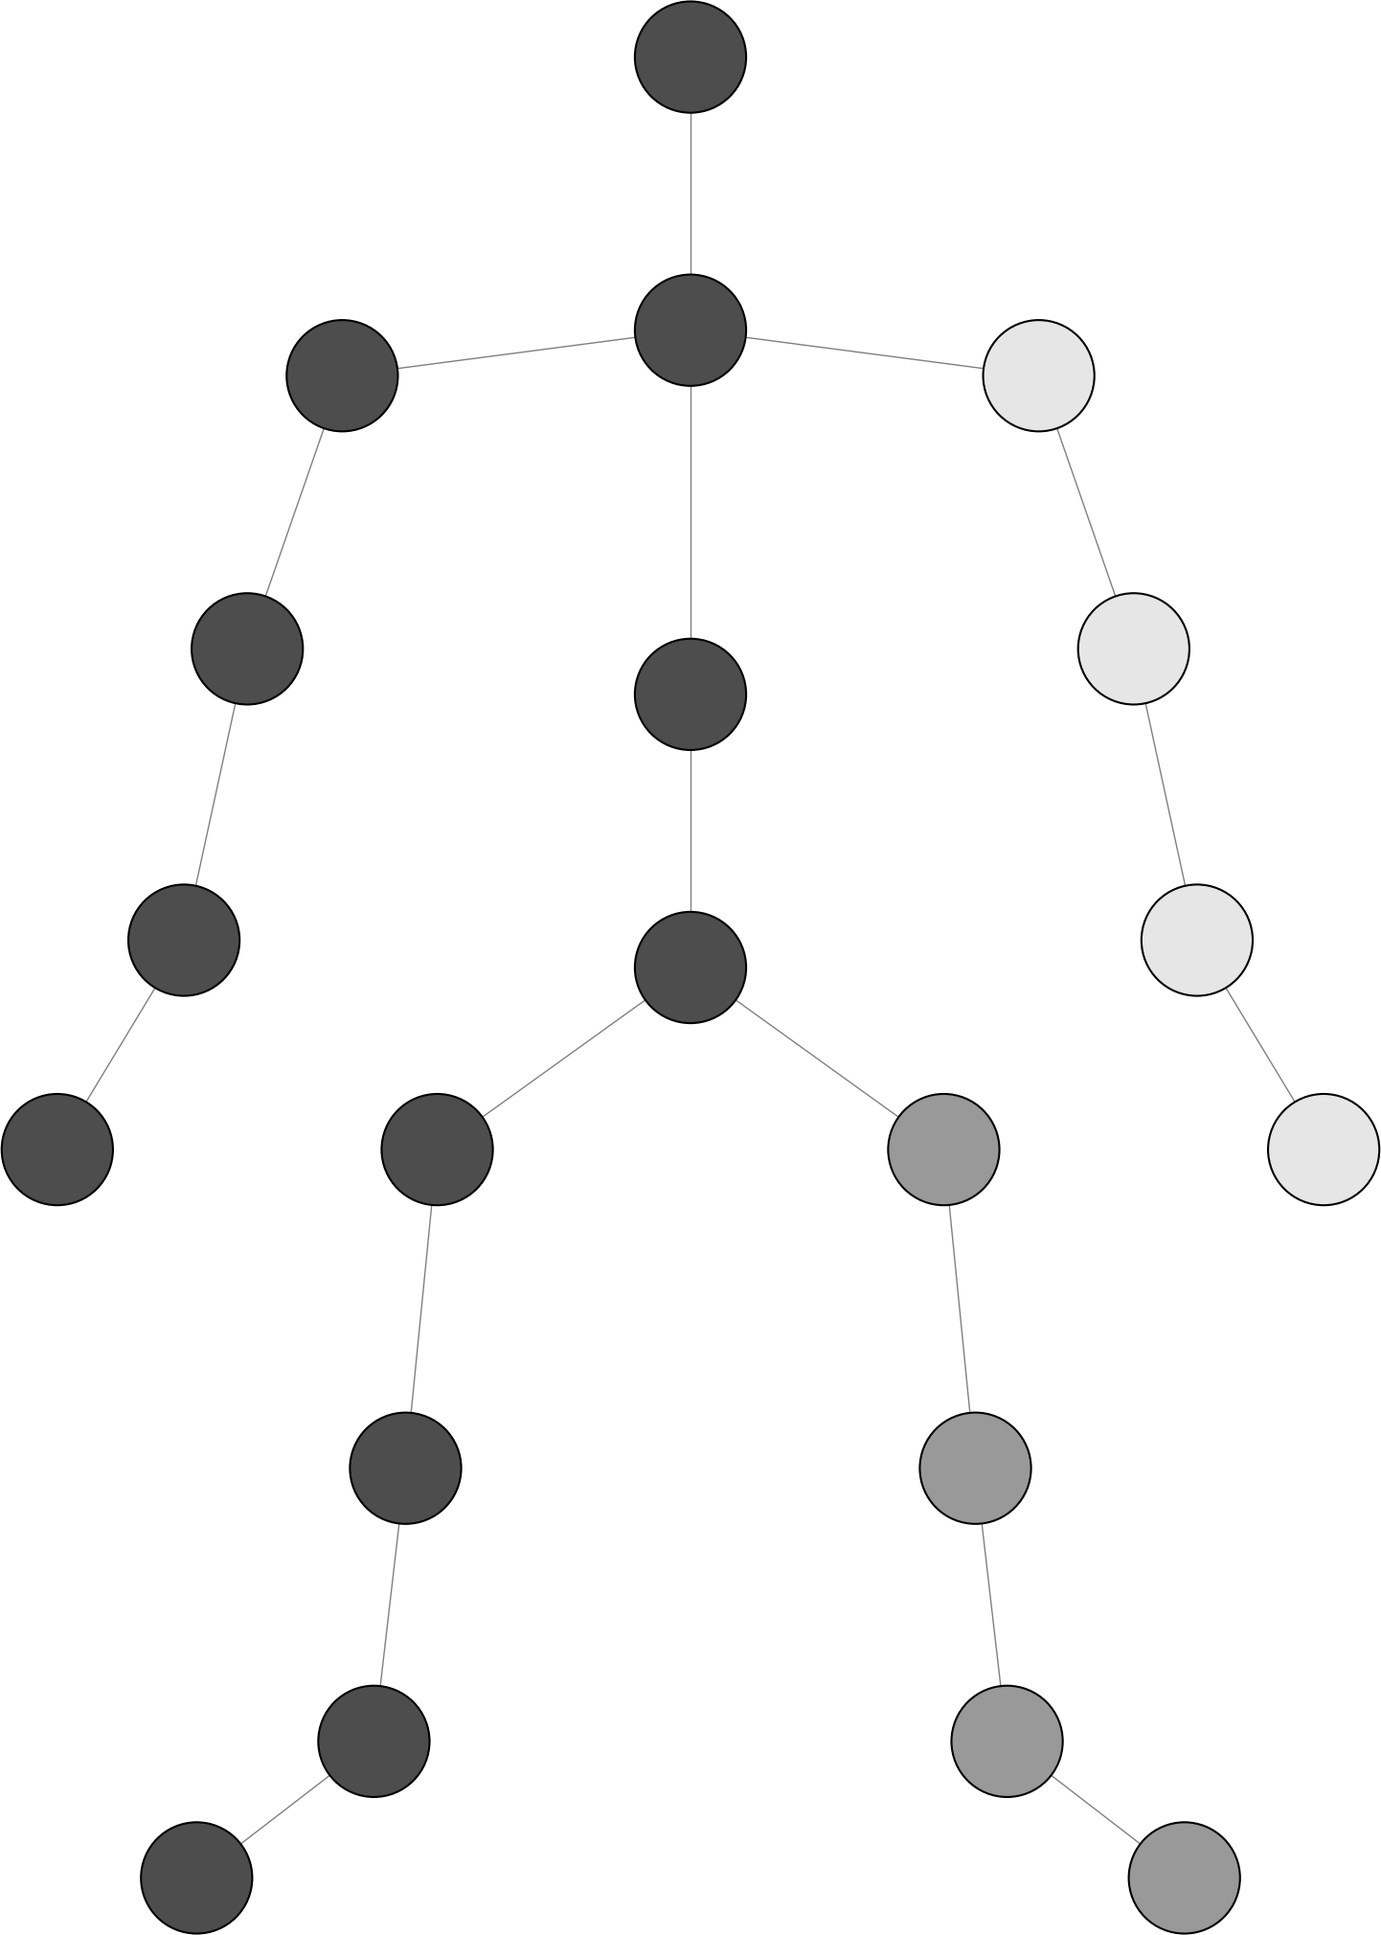
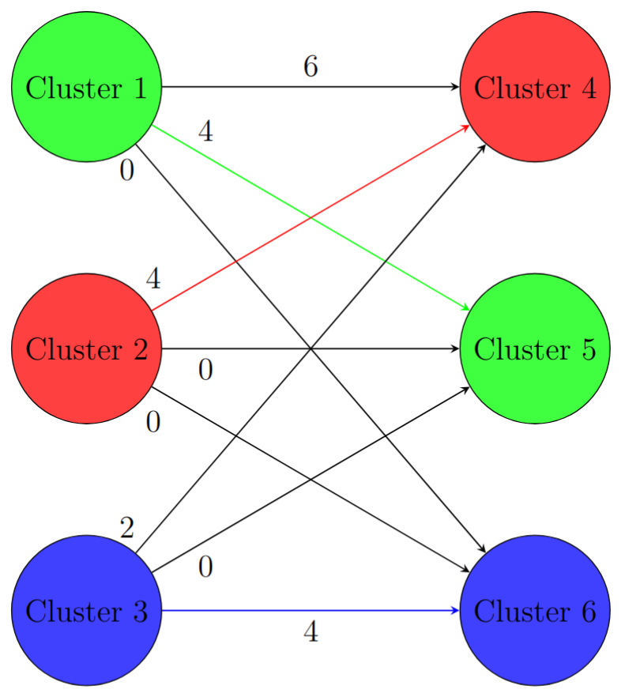
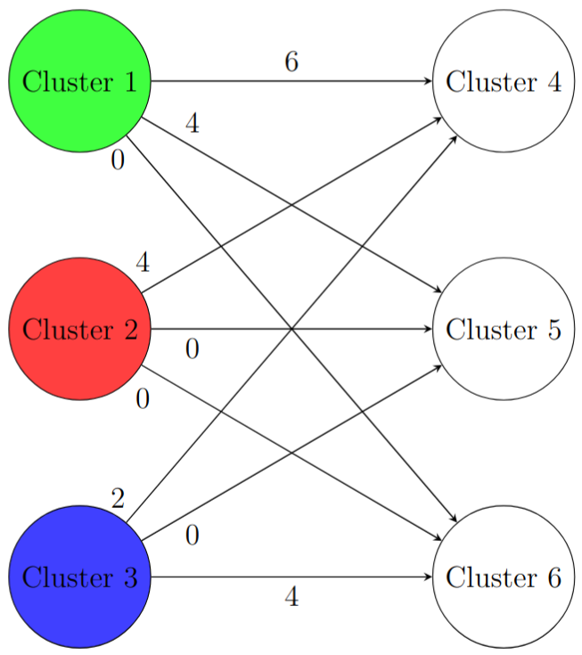
Visualization Approach
Initial clusters assignement
Clusters assignment at a subsequent frame
Maximum Weight Perfect Matching
The bipartite graph’s partitions are the clusters at subsequent frames
Cluster 3
Cluster 2
Cluster 6
Cluster 4
Cluster 1
Cluster 5
Edge’s weight is the number of nodes shared between clusters

Slide 12
Machine Learning Approach
What it is
Method enabling the binary classification of fragments from specific movements
What it is for
It can identify patterns in the features during the training phase that the algorithmic approach may overlook

Slide 13
Machine Learning Approach
Input 60 samples representing the
x, y, z trajectories
of
the 20-joints
for every frame
Best features selection
BorderlineSMOTE technique to
rebalance
the training set
Output Binary output indicating whether
the origin is
or
is not
in the selected class
Feature extraction
Extracted from the
distances
between joints and
the center of mass
for every frame
Classification
Model Random Forest
Classifier and
Leave One Out
Cross Validation

Slide 14
Algorithmic Approach - Results
Results
Chance level
Best results
On the dataset
36% accuracy
At least one correct node over the 20 possible
19% of chance
Feature Angular Momentum
Number of clusters
4
On samples not classified on an extremity of the skeleton
46% accuracy
At least one correct node over the 16 possible
24% of chance

Slide 15
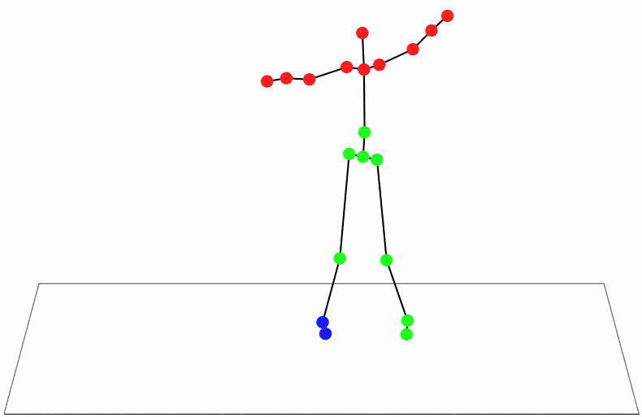



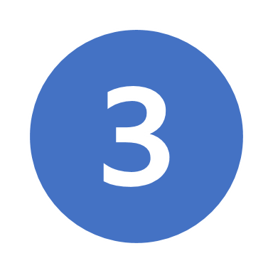
Visualization Approach - Results
Without cluster matching
With cluster matching
With cluster matching and smoothing

Slide 16
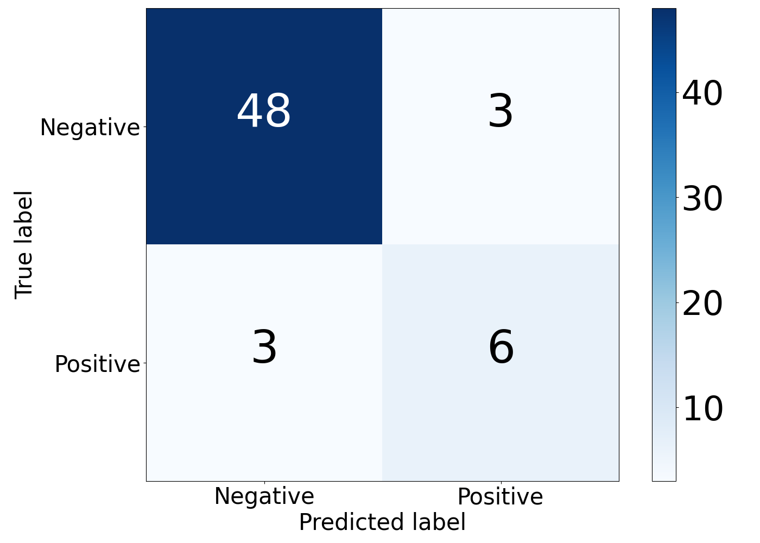
Machine Learning Approach - Results
Small and unbalanced dataset
We couldn't do deep learning neither multiclass classification
We opted for
binary classification
Works well on
the most frequent classes
Most frequent class
confusion matrix
True Skill Statistic:
80%

Slide 17
Conclusions and further researches
Conclusions
Future researches
Dataset was the main limitation due to the process required to obtain valid samples
With a larger dataset, will be possible multiclassification and deep learning techniques
Algorithmic and visualization approaches, due to limitations on clusters’ creation, cannot classify origins in the borders of the skeleton
Reduce the number of constraints in clusters’ creation
Multilabel classification on movement fragments characterized by multiple origins
Machine Learning approach works well on the most frequent classes

Slide 18
Thank you for your attention!

Slide 19
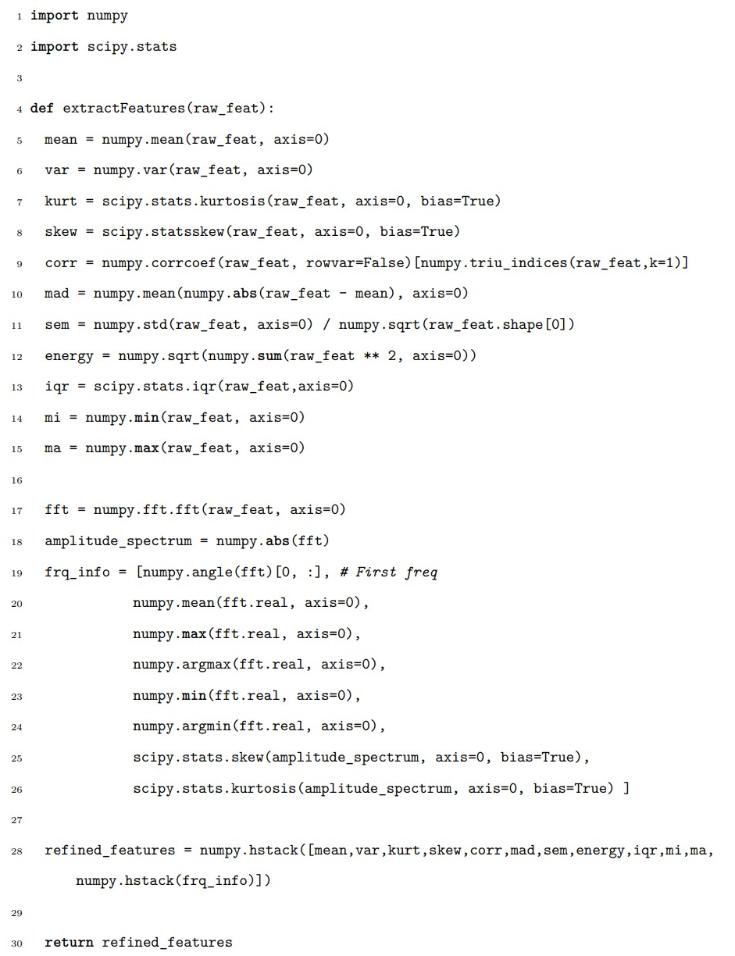
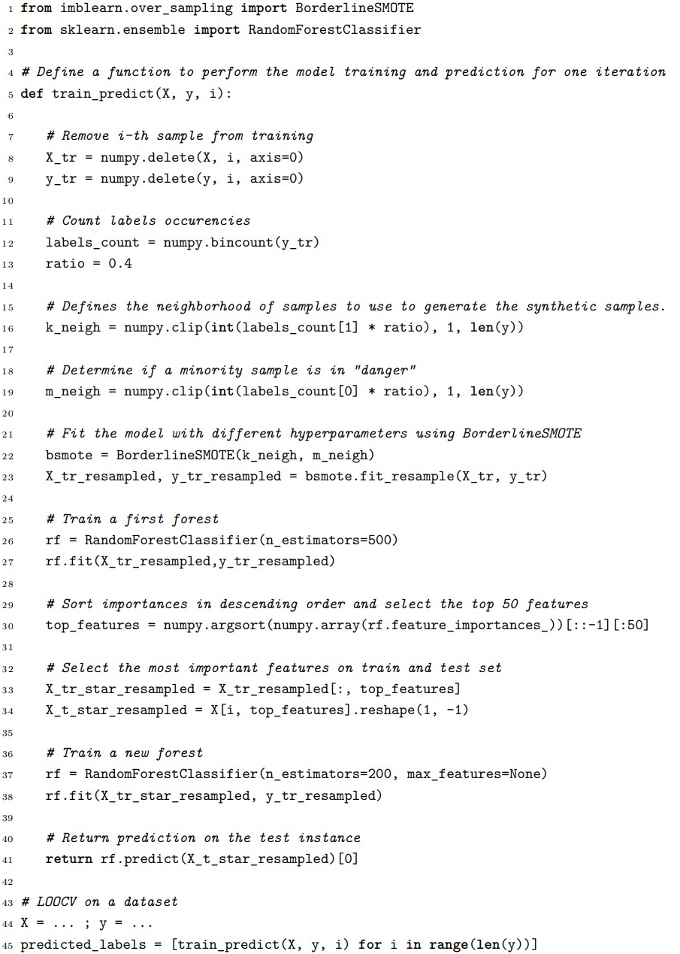
Machine Learning – Python Code

